Slide 1

Heart disease prediction using machine learning

Slide 2
Abstract
Cardiovascular diseases are the most common cause of death worldwide.
Over the last few decades in the developed as well as underdeveloped and developing countries.
Early detection of cardiac diseases and continuous supervision of clinicians can reduce the mortality rate.
However, it is not possible to monitor patients every day in all cases accurately and consultation of a patient for 24 hours by a doctor is not available since it requires more patience, time and expertise.
In this project, we have developed and researched about models for heart disease prediction through the various heart attributes of patient and detect impending heart disease using Machine learning techniques

Slide 3
Introduction
Every year 12 million deaths occur worldwide due to Heart Disease.
Many researches have been conducted in attempt to pinpoint the most influential factors of heart disease as well as accurately predict the overall risk.
The early diagnosis of heart disease plays a vital role in making decisions on lifestyle changes in high-risk patients and in turn reduce the complications.

Slide 4
System Level Block Diagram
Acquiring Data
Machine learning IDE
Results
Importing Data
Creating Machine Learning model

Slide 5
Problem Definition
The major challenge in heart disease is its detection.
There are instruments available which can predict heart disease but either they are expensive or are not efficient to calculate chance of heart disease in human.
Since we have a good amount of data in today’s world, we can use various machine learning algorithms to analyze the data for hidden patterns.

Slide 6
Objectives
To develop machine learning model to predict future possibility of heart disease by implementing different machine learning algorithms.
To determine significant risk factors based on medical dataset which may lead to heart disease.
To analyze feature selection methods and understand their working principle.

Slide 7
Literature Survey
Polaraju, Durga Prasad, and Tech Scholar in 2017⁠ proposed Prediction of Heart Disease using Multiple Regression Model and it proves that Multiple Linear Regression is appropriate for predicting heart disease chance.
Deepika and Seema in 2017 ⁠focuses on techniques that can predict chronic disease by mining the data containing in historical health records using Naïve Bayes, Decision tree, Support Vector Machine (SVM) and Artificial Neural Network (ANN).
Beyene and Kamat in 2018 ⁠recommended different algorithms like Naive Bayes, Classification Tree, KNN, Logistic Regression, SVM and ANN.
Sultana, Haider, and Uddin in 2017 proposed an analysis of cardiovascular disease. This paper proposed data mining techniques to predict the disease.

Slide 8
Requirements specification
Operating System: Windows 7 or any Linux Debian Distro
Language: Python or R
Tools: Jupyter notebook, Spyder, RStudio IDE
Processor: Intel or high
RAM: 1024 MB
Space on disk: minimum 100mb
For running the application:
Device: Any device that can access the internet
Minimum space to execute: 20 MB

Slide 9
Data Flow Diagram
DESIGN
Dataset
Preprocessing
Training the model
Prediction
Accuracy Calculation
Result

Slide 10
DESIGN
Module Level Block Diagram
Jupyter Notebook
Data Preprocessing
Training the model
Data collection
Data Analysis
Testing the data
Predictions and Results

Slide 11

Implementation
Importing Libraries
Numpy
Pandas
Matplotlib
Seaborn
Importing Dataset
Importing using pandas library

Slide 12
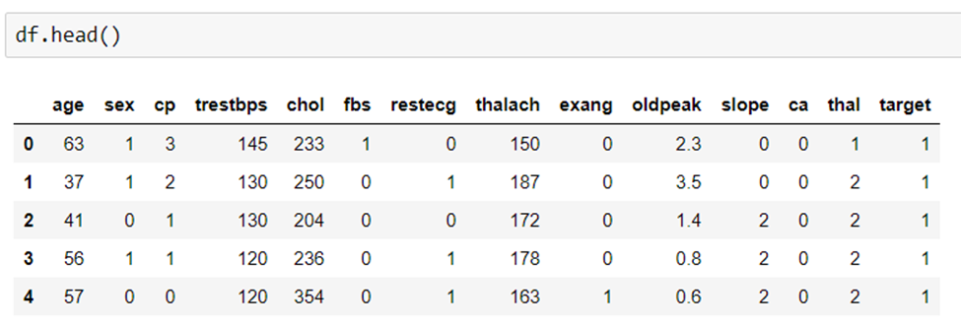
Implementation
Data Exploration
Finding the shape of the dataset.
Finding missing values.
Finding the number of categorical columns.
Finding the int type and float type columns.
Finding the basic insights about the features using describe() function.

Slide 13
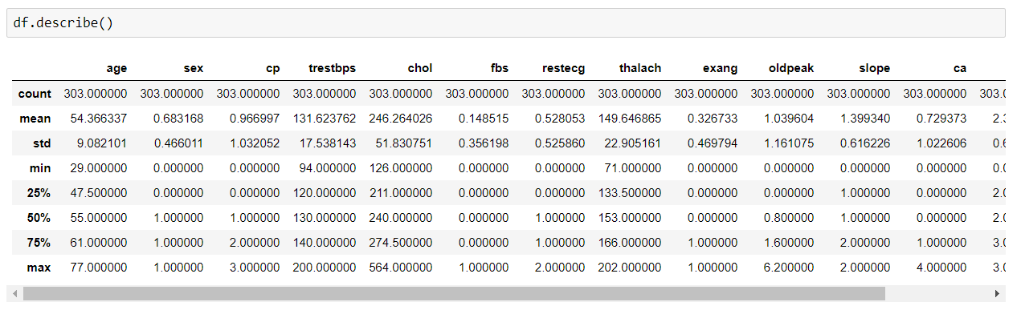
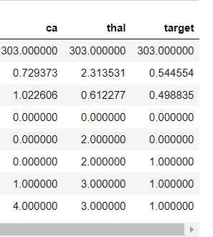
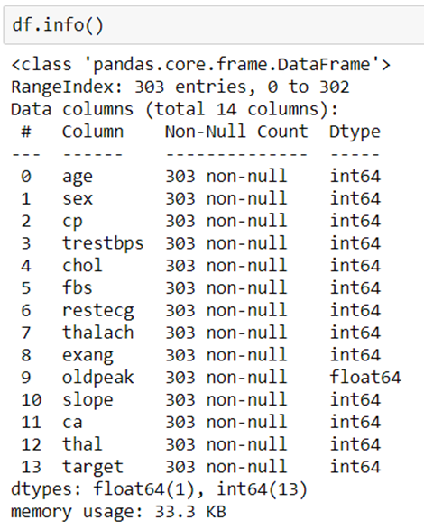

Slide 14
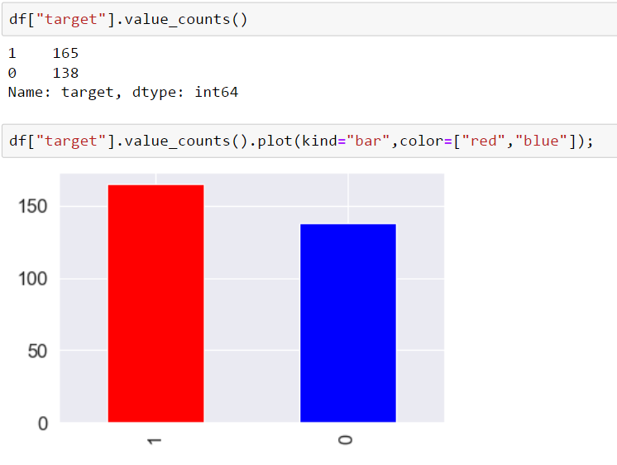
Implementation
Data Visualization
Finding useful insights using various seaborn and matplotlib.
Finding the correlation between each feature.
Finding how data is distributed across various features.
For example finding what age group are most likely to get heart disease.

Slide 15
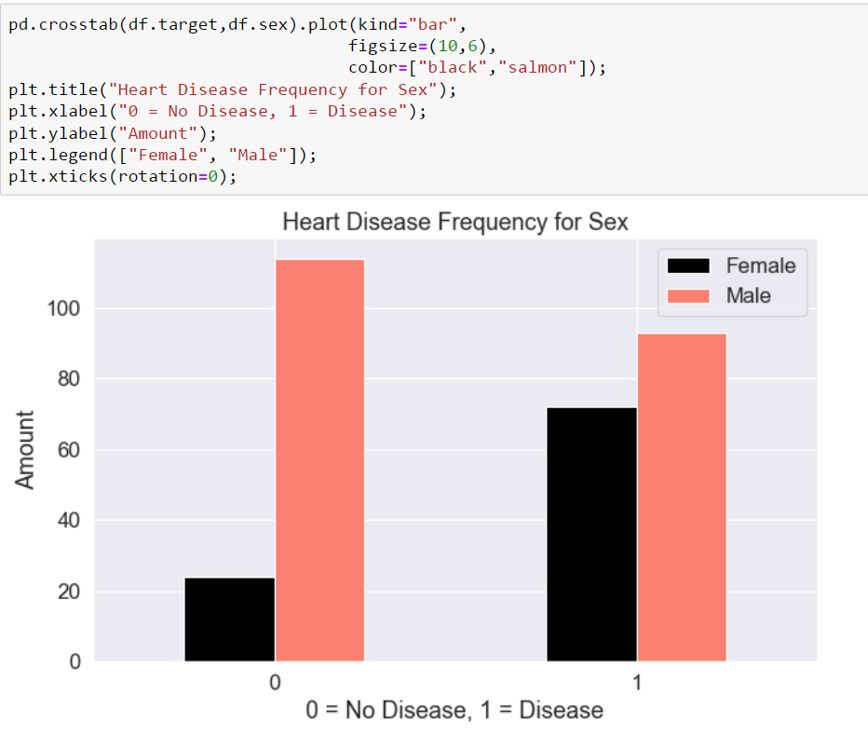
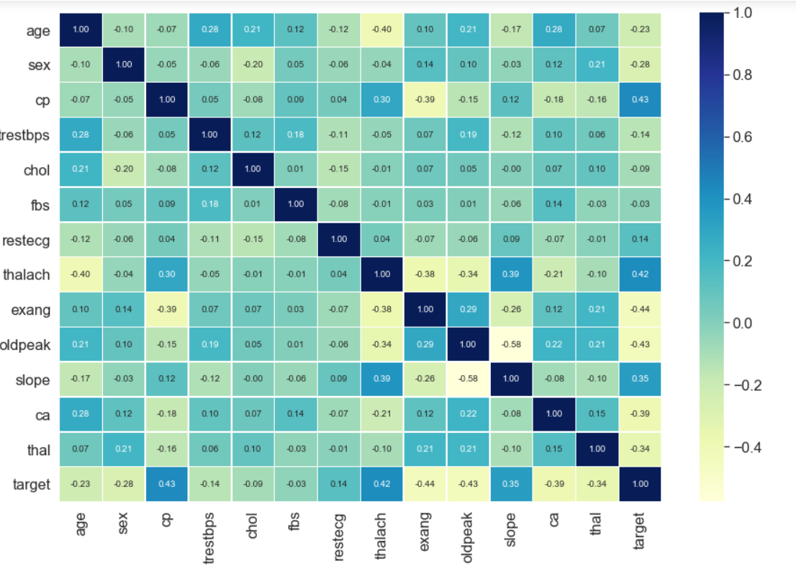
Implementation

Slide 16

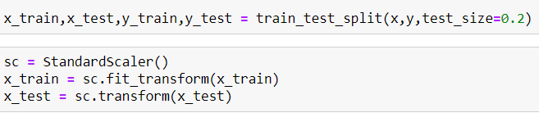
Implementation
Splitting the dataset into training and testing data
Assigning all the features to x except target column.
Assigning target column to y.
Splitting x and y into x_train, x_test, y_train, y_test.
Applying standard scaler to x_train, and x_test.

Slide 17
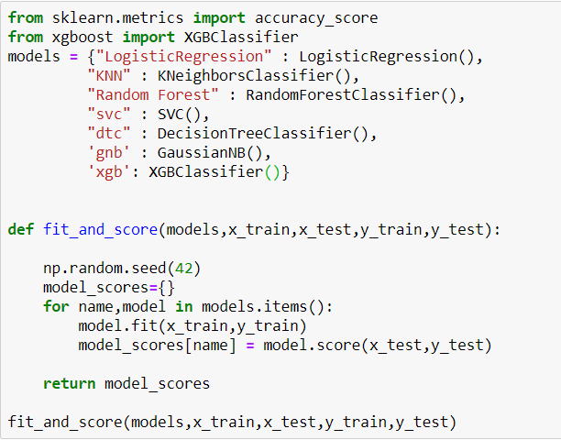
Implementation
Model training and evaluating
Importing classification machine learning algorithms.
Training and finding the scores of each model.
Finding the model the with best score.

Slide 18
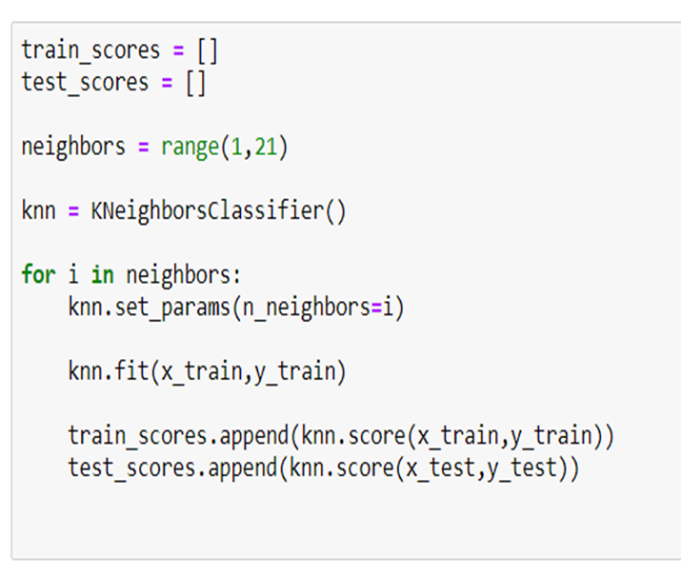
Implementation
Improving accuracy
Improving accuracy using Parameters Tuning.
Checking whether accuracy increased or not.
Finding the best parameters and best algorithm for the prediction.

Slide 19
Results
Algorithms used | Accuracy score | Precision Score | Recall score | F1 score
Logistic Regression | 85.24% | 87% | 84% | 86%
Random Forest Classifier | 83.6% | 85% | 88% | 86%
Super Vector Classifier | 86.88% | 90% | 84% | 87%
K Nearest Neighbors | 90.16% | 93% | 88% | 90%
Decision Tree Classifier | 83.6% | 85% | 69% | 76%
Guassian Naïve Bayes | 86.88% | 90% | 84% | 87%
XGB Classifier | 81.96% | 86% | 78% | 82%

Slide 20
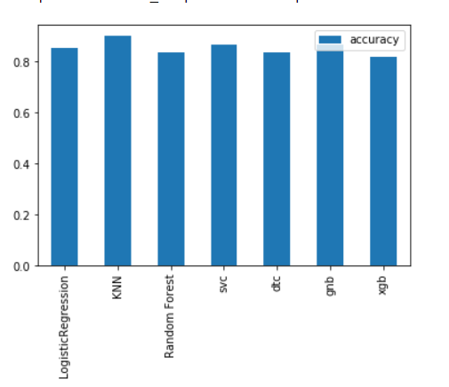
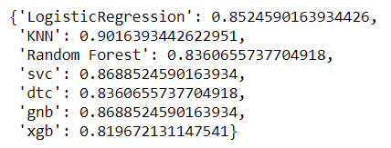
Results

Slide 21
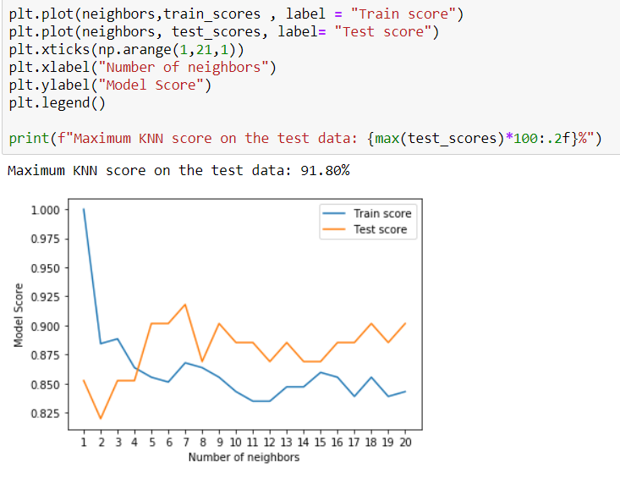
Results
Algorithms used | Accuracy after Parameter tuning
KNN | 91.8%
SVC | 90.16%
Logistic Regression | 89%
Random Forest | 86.8%

Slide 22
Summary of results
KNN model is the best algorithm among all other algorithms.
Before parameter tuning accuracy of KNN is 90.16%
After parameter tuning accuracy of KNN is 91.8%
Although the accuracy of SVC, Logistic Regression and Random Forest Classifier increased after parameter tuning they couldn’t increase as much as KNN.

Slide 23
Conclusion
The early prognosis of cardiovascular diseases can aid in making decisions on lifestyle changes in high risk patients and in turn reduce the complications, which can be a great milestone in the field of medicine.
This project used all the best classification models and successfully predict the heart disease, with 92% accuracy.
The model predicted is KNN.
Further for its enhancement, we can train on models and predict the types of cardiovascular diseases providing recommendations to the users, and also use more enhanced models.

Slide 24
Thank you

